Slide 1
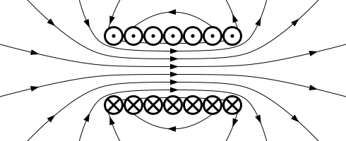
S
N
weak field:
field lines wide spread
strong magnetic field:
field lines close together

Slide 2
N
S
the magnetic field in the region
between the poles is nearly uniform

Slide 3
N
S
N
S
opposite poles attract each other
N
S
N
S
N
S
N
S
similar poles repel each other

Slide 4
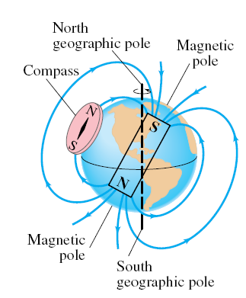
south magnetic pole
north magnetic pole

Slide 5
S
N

Slide 6
direction of B-field given by right hand rule
B-field increases with increasing I
B
R
I
B-field decreases with increasing R
B
current I into page
R

Slide 7
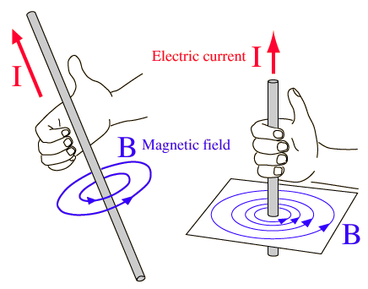

Slide 8
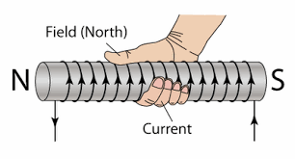

Slide 9
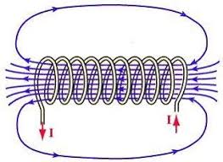

Slide 10
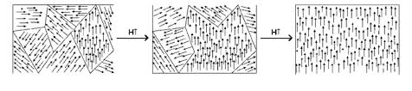
non-magnetic
weakly magnetic
strongly magnetic

Slide 11
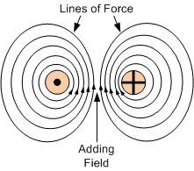
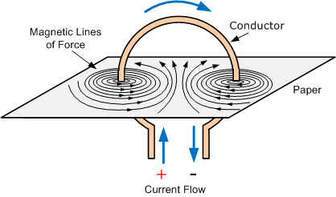

Slide 12
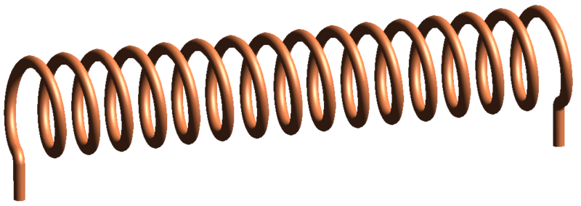
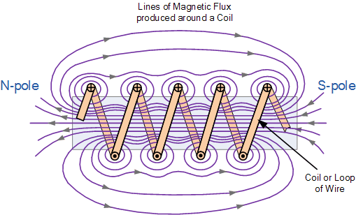

Slide 13
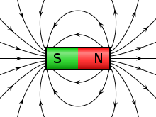
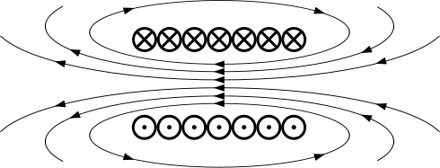

Slide 14
current I
B-field
B-field
strong B-field
strong B-field

Slide 17
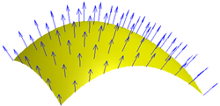
Magnetic flux for constant B-field
Each point on a surface is associated with a direction, called the surface normal; the magnetic flux through a point is then the component of the magnetic field along this direction
θ

Slide 18
S
N
right hand palm rule
thumb
fingers
palm
facing down

Slide 19
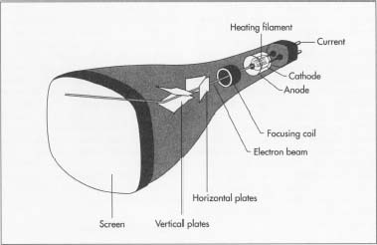

Slide 20
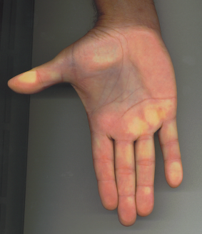
+
q
+
I
out of page

Slide 22
motion of a
positive charge in a magnetic field
palm face
fingers
θ
thumb
v (+q)
thumb
fingers
θ
motion of a negative charge in a magnetic field
palm face

Slide 23
N
+y
thumb
S
fingers
e⁻
+x
palm face
+z
beam will be deflected
to the right
right hand palm rule

Slide 24
negative charge
R
R
positive charge
B-field into page

Slide 25
F_{B} > F_{E}
electric field
down the page
B-field into page
F_{B} = F_{E}
positive charge
v

Slide 26
uniform magnetic field
thumb
conductor
θ
palm:
force into page
fingers
uniform magnetic field directed into page

Slide 27
coil winding attached to speaker cone
B-field
N
current through coils
I
S
force on cone
N
speaker cone
permanent magnet
rigid frame attached to
magnet and speaker cone

Slide 28
scale
pointer
spring
S
N
force on coil
into page
force on coil out of page
pivot

Slide 29
pointer / spring
N
S
magnet
iron core
core windings I

Slide 30
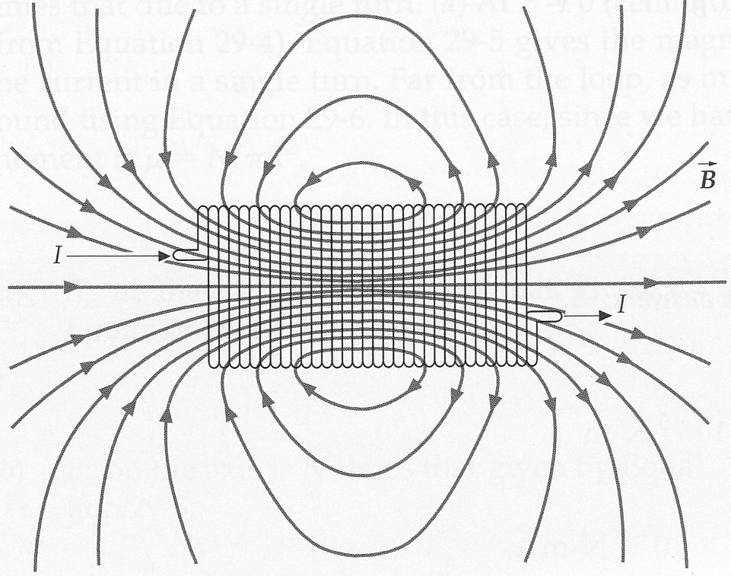
S
N
I

Slide 31
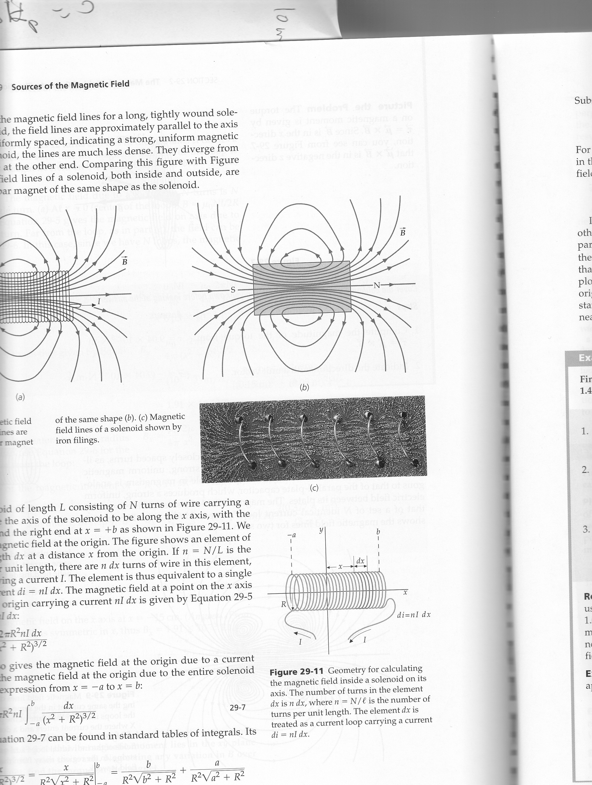
strong field:
high density of B-lines
S
N
weak field:
low density of B-lines
S
N
compass needles / magnets
align along B-field

Slide 32
S
N

Slide 35
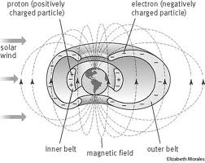

inner belt:
positively charged protons
outer belt:
negatively charged electrons
N
solar
wind
S
B-field

Slide 36
inner belt:
positively charged protons
outer belt:
negatively charged electrons
solar
wind
S
B-field

Slide 37
strong magnetic field
magnetic field line
electron motion
weak magnetic field
proton motion
strong magnetic field
spiral path of trapped charged particle

Slide 39
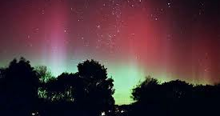

Slide 40
currents I₁ and I₂ are into page
force on conductor 2
due to conductor 1
1
2
F
d
think of two railway tracks merging in the distance – currents in the same direction attract
d

Slide 41
current I₁ out of page and I₂ are into page
1
2
force on conductor 1
due to conductor 2
d
F
F
d

Slide 42
I₁ = 100 A
d = 0.350 m
F_{B}
currents in same direction attract
I₂ = ? A
F_{G} = mg = (m/L) g L
g = 9.81 m.s⁻²
m/L = 0.150 g.m⁻¹ = 1.50×10⁻⁴ kg.m⁻¹
μ_{o} = 4π×10⁻⁷ T.m.A⁻¹
μ_{o} / 2π = 2×10⁻⁷ T.m.A⁻¹

Slide 43
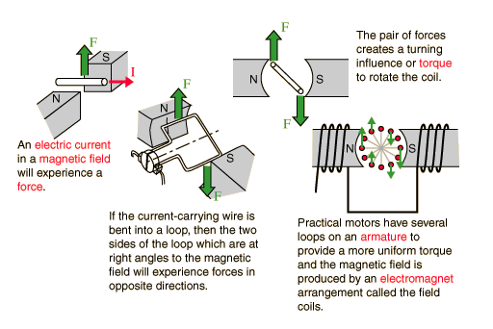

Slide 44
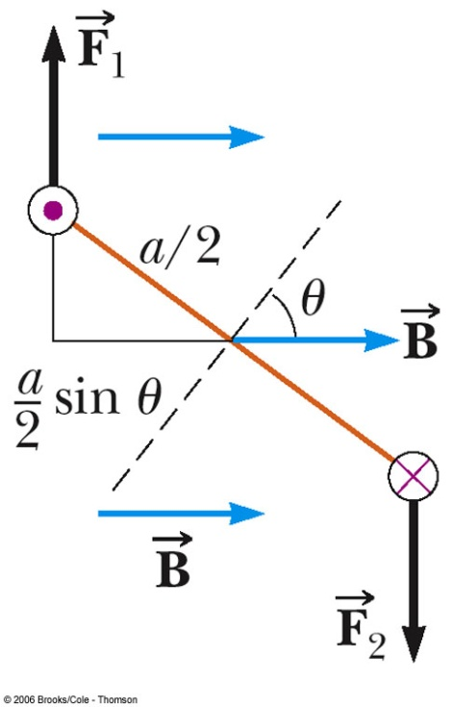

Slide 45
+ Q
+ + + + + + + + + +
V
d
-
-
-
-
-
-
-
-
-
-
- Q

Slide 46
+z (up)
+y (in)
+x (right)
N
rotation axis (y)
C
vector showing direction of loop which is perpendicular to plane of the loop
B
D
I
S
b
A
a

Slide 47
line of action of F
pivot
clockwise rotation
θ
axis of rotation
θ
point of application of F
lever arm
θ
θ
θ
θ

Slide 48
(0,0)
(0,0)
(0,0)

Slide 49
C
B
I
D
A

Slide 50
electrons move from rim to centre of disc
⇒ current through globe is from Y to X
v
B
brush Y
F
brush X
v motion of electron in disc
B
F
force on electron:
electrons move from
rim of disc to centre

Slide 51
E ≠ 0 B = 0
E = 0 B = 0
E = 0 B ≠ 0

Slide 53
B_{induced}
right hand
screw rule
right hand
screw rule
I_{induced}
B_{magnet}
B_{magnet}
I_{induced}
B_{induced}
G
G
Lenz’s law: induced current produces a magnetic field to oppose the motion of the magnet entering the coil
Lenz’s law: induced current produces a magnetic field to oppose the motion of the magnet existing the coil

Slide 54
N
S
F
brushes
Commutator (rotates with coil)

Slide 55
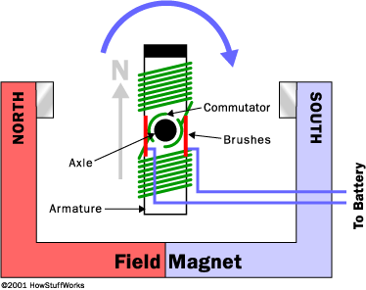

Slide 56
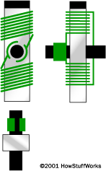

Slide 57
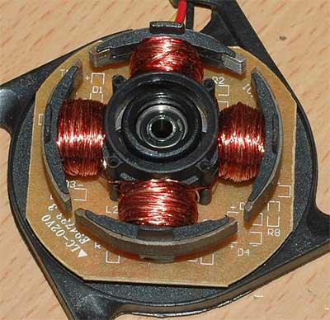

Slide 58
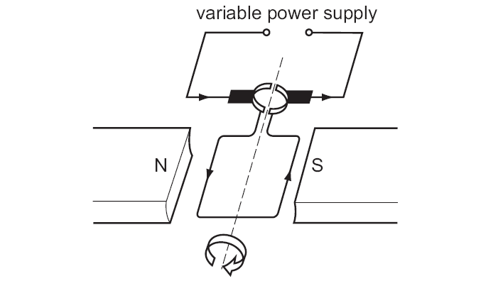

Slide 59
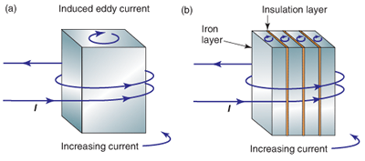
induced eddy current
insulation layer
iron layer
increasing current
increasing current
eddy current cause a heating effect
laminations reduce magnitude of eddy currents
⇒ less ohmic heating ( I ² R )

Slide 60
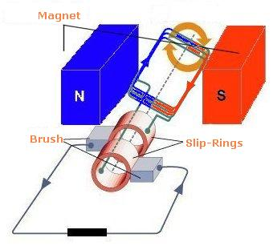

Slide 61
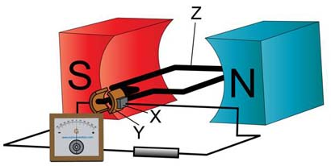

Slide 62
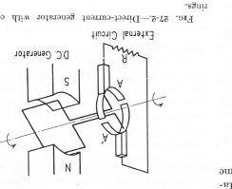
DC generator
rotation of coil in magnetic field → changing magnetic flux → induced emf → DC current through external circuit
brush
commutator:
split ring
N
rotating coil on armature
S
brush
external circuit

Slide 63
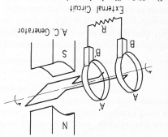
AC generator
rotation of coil in magnetic field → changing magnetic flux → induced emf → AC current through external circuit
commutator:
slip ring
S
S
rotating coil
on armature
brush
external circuit

